Slide 1



Graph Convolutional Networks:
Theory and Fundamentals
Zhewei Wei
2023-03

Slide 2
Outline
Overview of GNNs
Spectral interpretation of GNNs
Our works (GCNII, BernNet, ChebNetII)
Summary & Perspectives

Slide 3
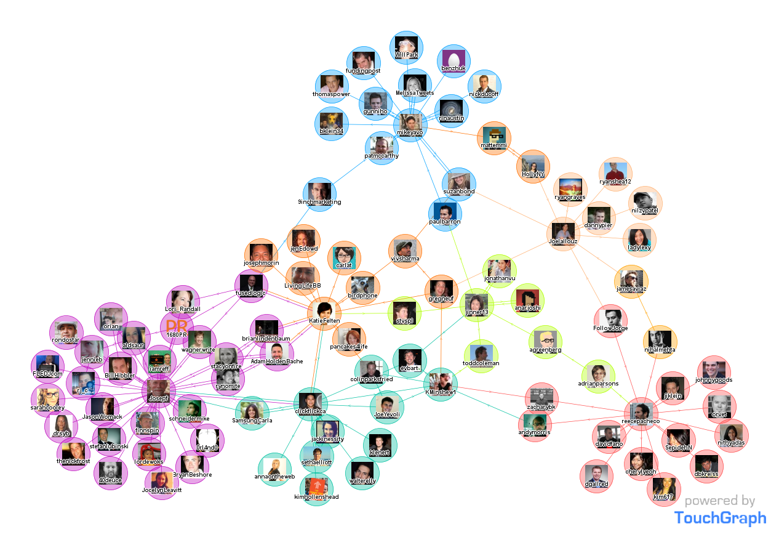
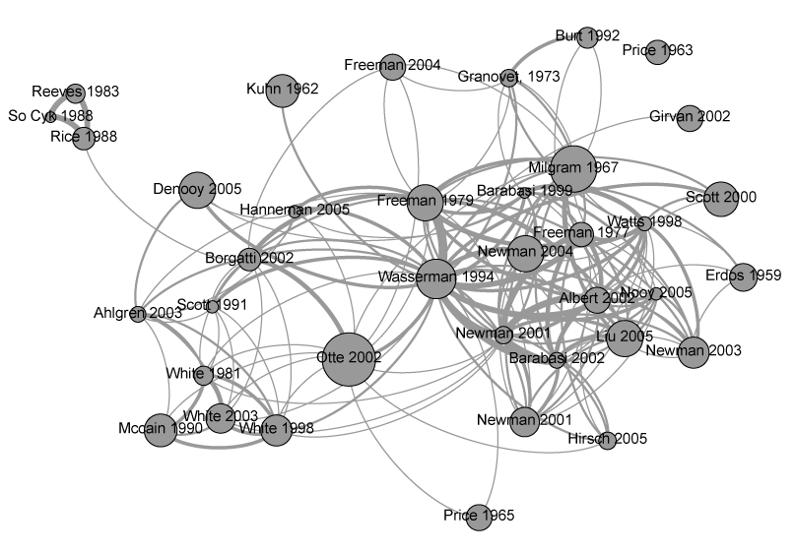
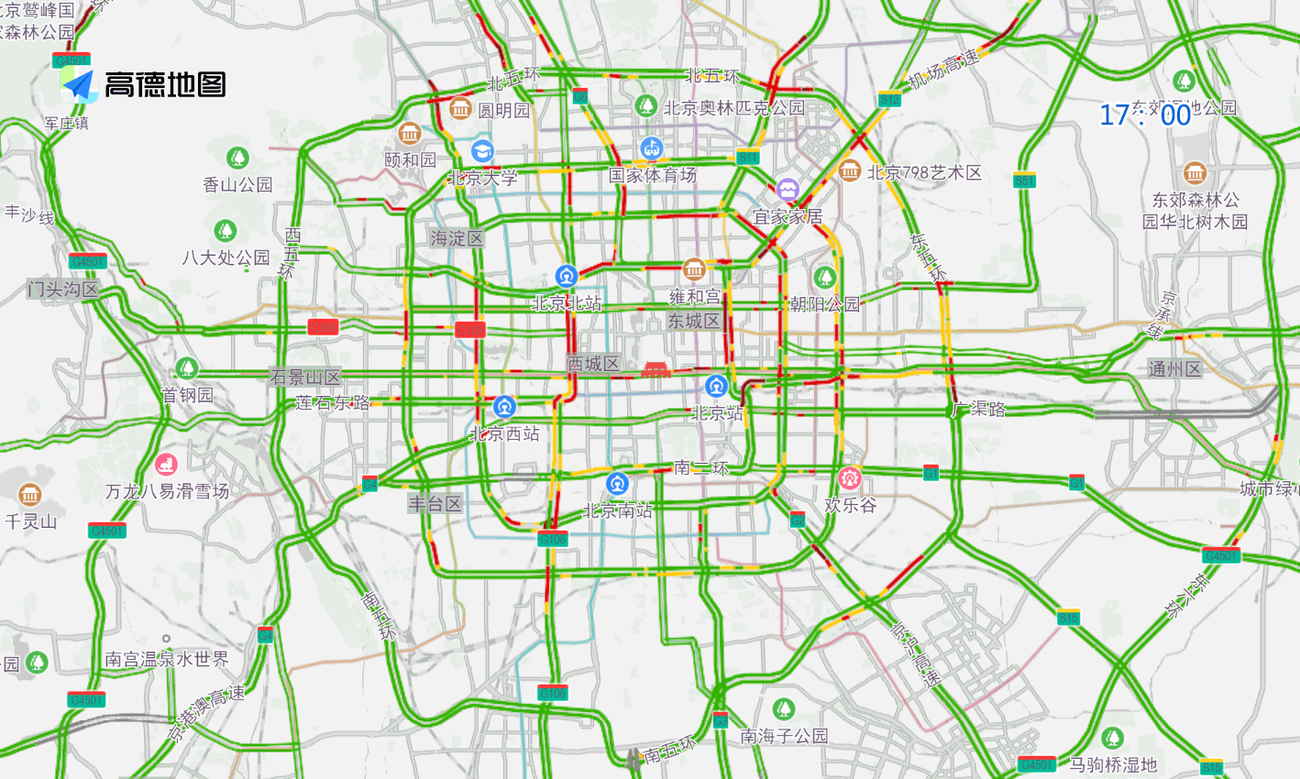
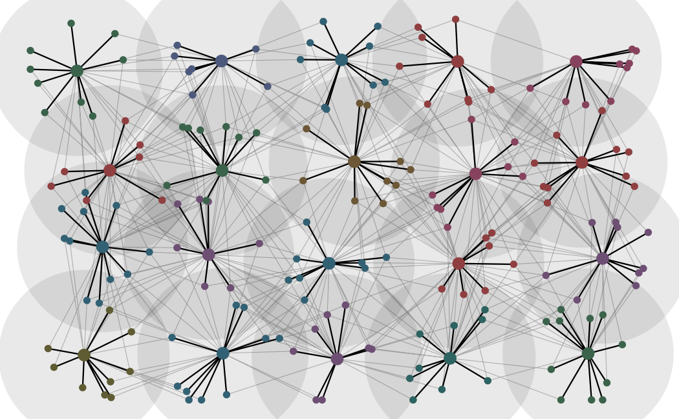
Graphs are ubiquitous
Social Network
Citation Network
Protein Network
Road Network
Signal Network

Slide 4
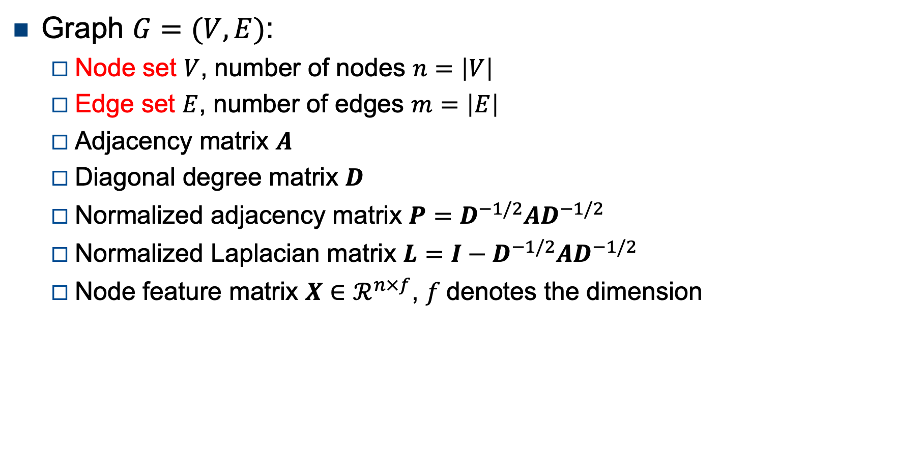
Graph
Graph $G=(V,E)$:
Node set $V$, number of nodes $n=\left|V\right|$
Edge set $E$, number of edges $m=\left|E\right|$
Adjacency matrix $A$
Diagonal degree matrix $D$
Normalized adjacency matrix $P=D^{−1/2}AD^{−1/2}$
Normalized Laplacian matrix $L=I−D^{−1/2}AD^{−1/2}$
Node feature matrix $X∈ℛ^{n×f}$, $f$denotes the dimension
1
0
2
5
3
4

Slide 5

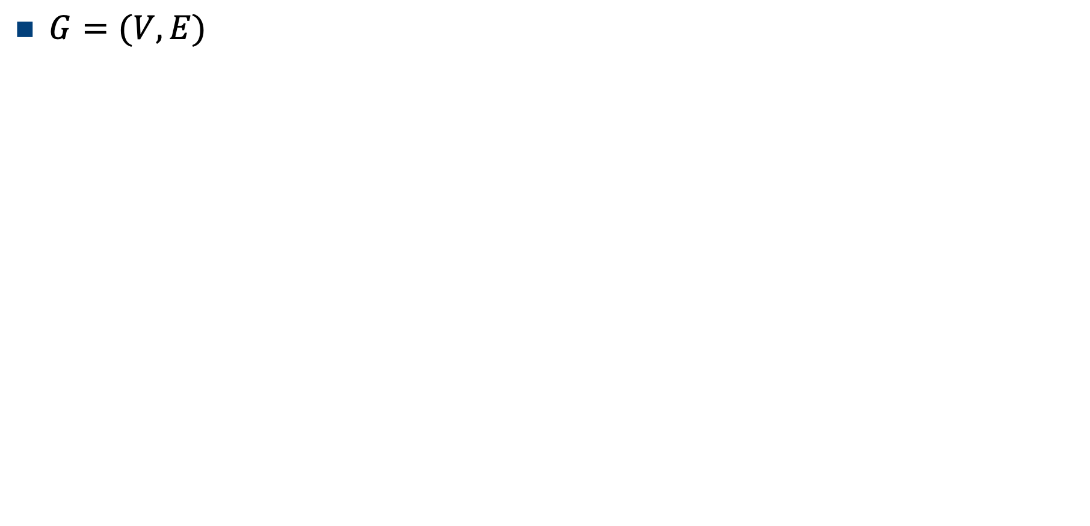
Graph
1
$G=(V,E)$
0 | 1 | 1 | 1 | 0 | 0
1 | 0 | 1 | 0 | 0 | 0
1 | 1 | 0 | 0 | 1 | 1
1 | 0 | 0 | 0 | 0 | 0
0 | 0 | 1 | 0 | 0 | 1
0 | 0 | 1 | 0 | 1 | 0
0
2
5
3
4
Adjacency matrix $A=$

Slide 6

Graph
1
$G=(V,E)$
3 | 0 | 0 | 0 | 0 | 0
0 | 2 | 0 | 0 | 0 | 0
0 | 0 | 4 | 0 | 0 | 0
0 | 0 | 0 | 1 | 0 | 0
0 | 0 | 0 | 0 | 2 | 0
0 | 0 | 0 | 0 | 0 | 2
0
2
5
3
4
Degree matrix $D=$

Slide 7


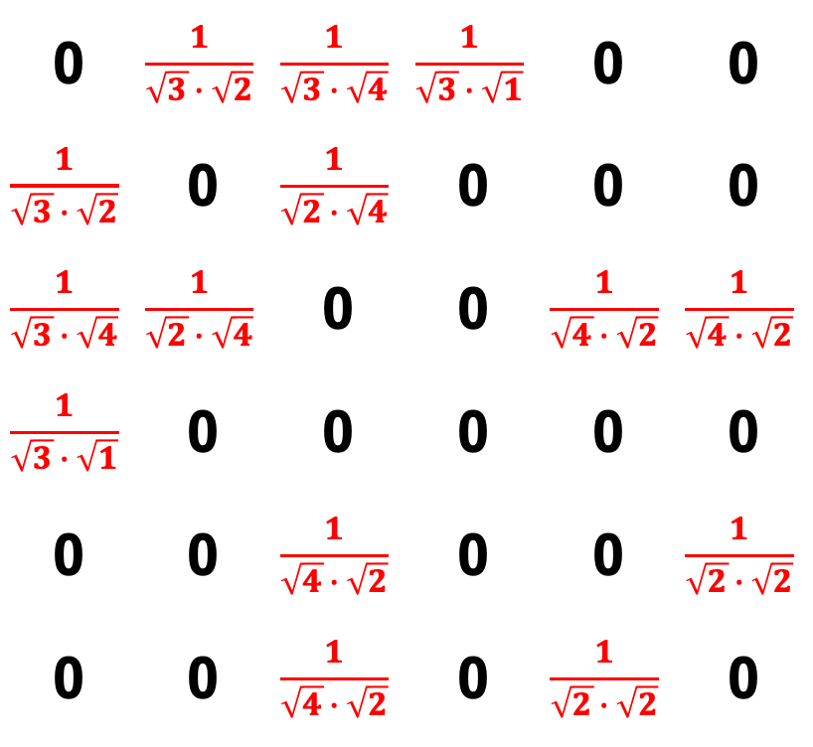
Graph
$$P=D^{−1/2}AD^{−1/2}$$
1
$G=(V,E)$
0 | $$\frac{1}{\sqrt{3}∙\sqrt{2}}$$ | $$\frac{1}{\sqrt{3}∙\sqrt{4}}$$ | $$\frac{1}{\sqrt{3}∙\sqrt{1}}$$ | 0 | 0
$$\frac{1}{\sqrt{3}∙\sqrt{2}}$$ | 0 | $$\frac{1}{\sqrt{2}∙\sqrt{4}}$$ | 0 | 0 | 0
$$\frac{1}{\sqrt{3}∙\sqrt{4}}$$ | $$\frac{1}{\sqrt{2}∙\sqrt{4}}$$ | 0 | 0 | $$\frac{1}{\sqrt{4}∙\sqrt{2}}$$ | $$\frac{1}{\sqrt{4}∙\sqrt{2}}$$
$$\frac{1}{\sqrt{3}∙\sqrt{1}}$$ | 0 | 0 | 0 | 0 | 0
0 | 0 | $$\frac{1}{\sqrt{4}∙\sqrt{2}}$$ | 0 | 0 | $$\frac{1}{\sqrt{2}∙\sqrt{2}}$$
0 | 0 | $$\frac{1}{\sqrt{4}∙\sqrt{2}}$$ | 0 | $$\frac{1}{\sqrt{2}∙\sqrt{2}}$$ | 0
0
2
5
3
4
Normalized adjacency matrix
$$P=$$

Slide 8

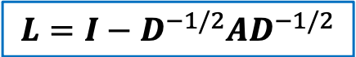
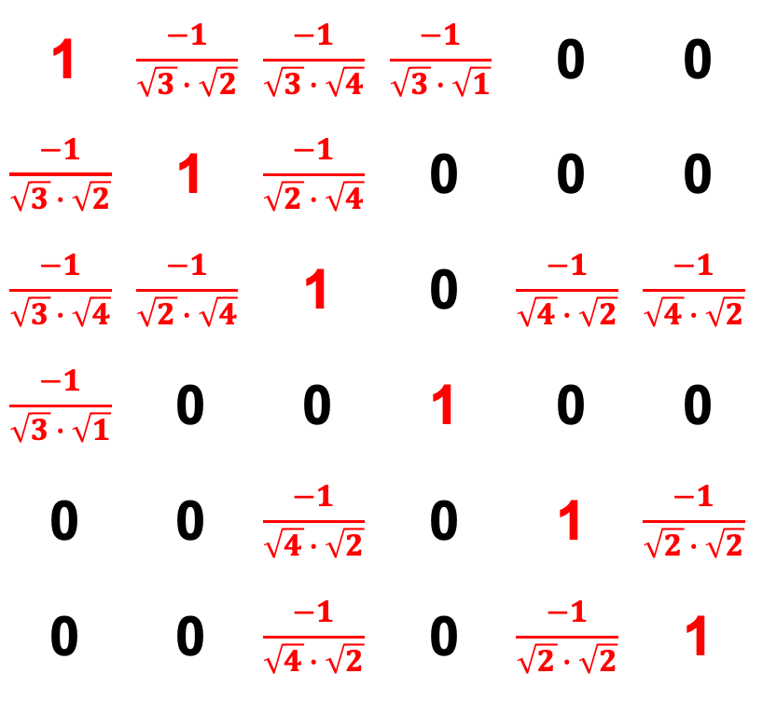
Graph
$$L=I−D^{−1/2}AD^{−1/2}$$
1
$G=(V,E)$
1 | $$\frac{−1}{\sqrt{3}∙\sqrt{2}}$$ | $$\frac{−1}{\sqrt{3}∙\sqrt{4}}$$ | $$\frac{−1}{\sqrt{3}∙\sqrt{1}}$$ | 0 | 0
$$\frac{−1}{\sqrt{3}∙\sqrt{2}}$$ | 1 | $$\frac{−1}{\sqrt{2}∙\sqrt{4}}$$ | 0 | 0 | 0
$$\frac{−1}{\sqrt{3}∙\sqrt{4}}$$ | $$\frac{−1}{\sqrt{2}∙\sqrt{4}}$$ | 1 | 0 | $$\frac{−1}{\sqrt{4}∙\sqrt{2}}$$ | $$\frac{−1}{\sqrt{4}∙\sqrt{2}}$$
$$\frac{−1}{\sqrt{3}∙\sqrt{1}}$$ | 0 | 0 | 1 | 0 | 0
0 | 0 | $$\frac{−1}{\sqrt{4}∙\sqrt{2}}$$ | 0 | 1 | $$\frac{−1}{\sqrt{2}∙\sqrt{2}}$$
0 | 0 | $$\frac{−1}{\sqrt{4}∙\sqrt{2}}$$ | 0 | $$\frac{−1}{\sqrt{2}∙\sqrt{2}}$$ | 1
0
2
5
3
4
Normalized Laplacian matrix
$$L=$$

Slide 9
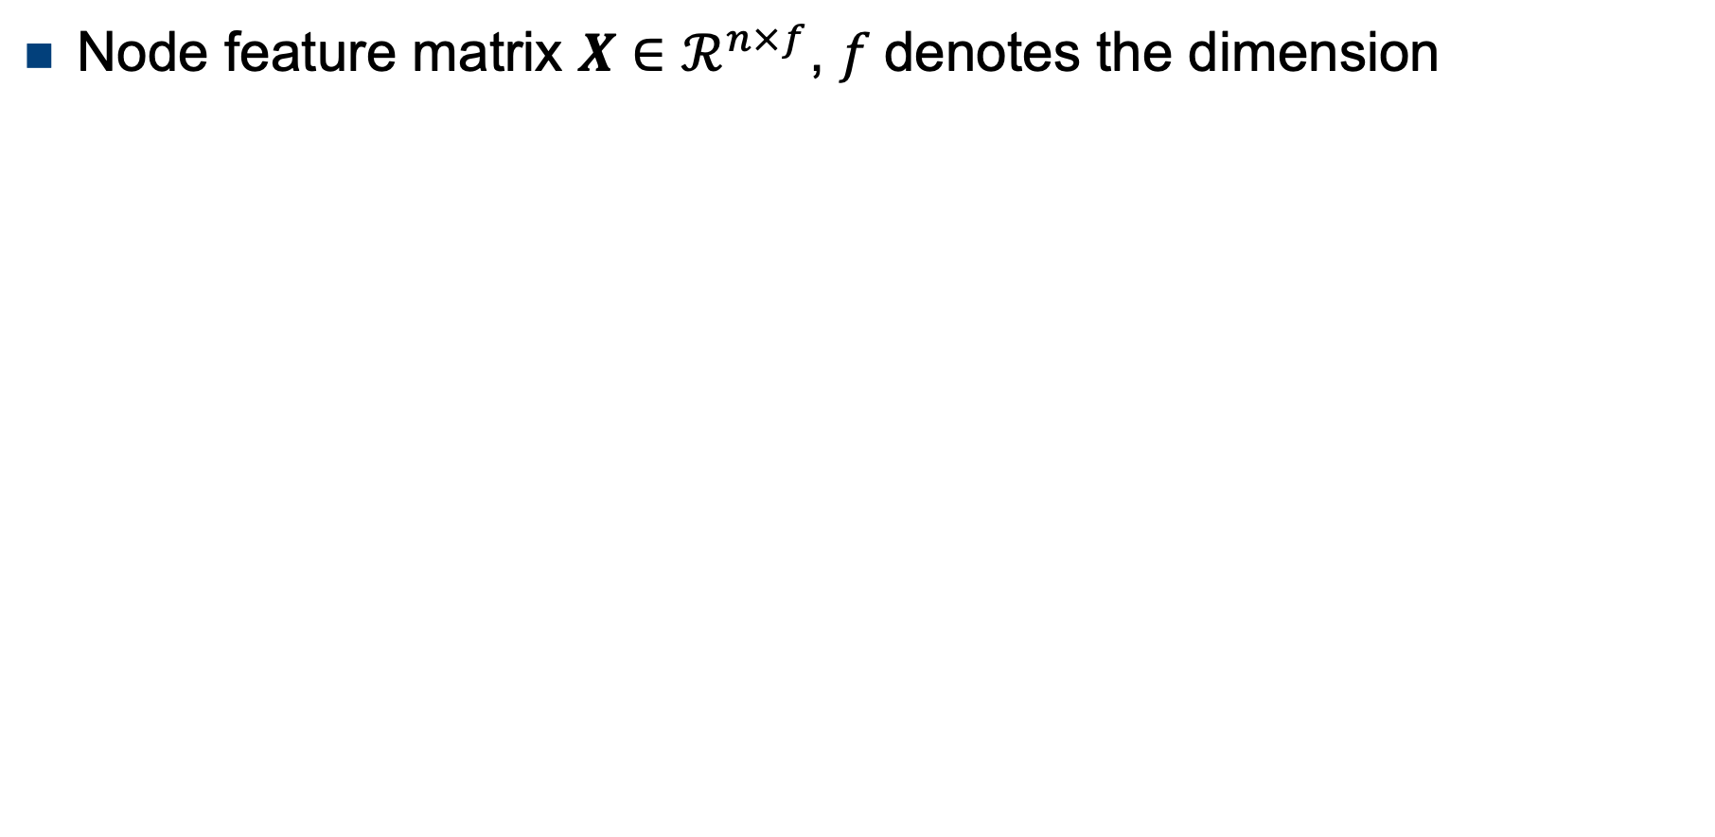
Graph
1
Node feature matrix $X∈ℛ^{n×f}$, $f$denotes the dimension
0
2
5
3
4
Node | Features1 | Features2 | Features3 | Features4 | Features5 | Features6
x₀ | 1 | 0 | 0 | 0 | 0 | 0
x₁ | 0 | 1 | 0 | 0 | 0 | 0
x₂ | 0 | 0 | 1 | 0 | 0 | 0
x₃ | 0 | 0 | 0 | 1 | 0 | 0
x₄ | 0 | 0 | 0 | 0 | 1 | 0
x₅ | 0 | 0 | 0 | 0 | 0 | 1

Slide 10
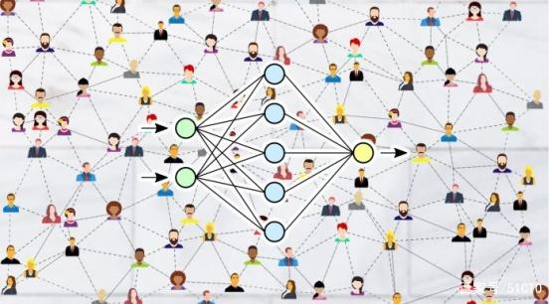
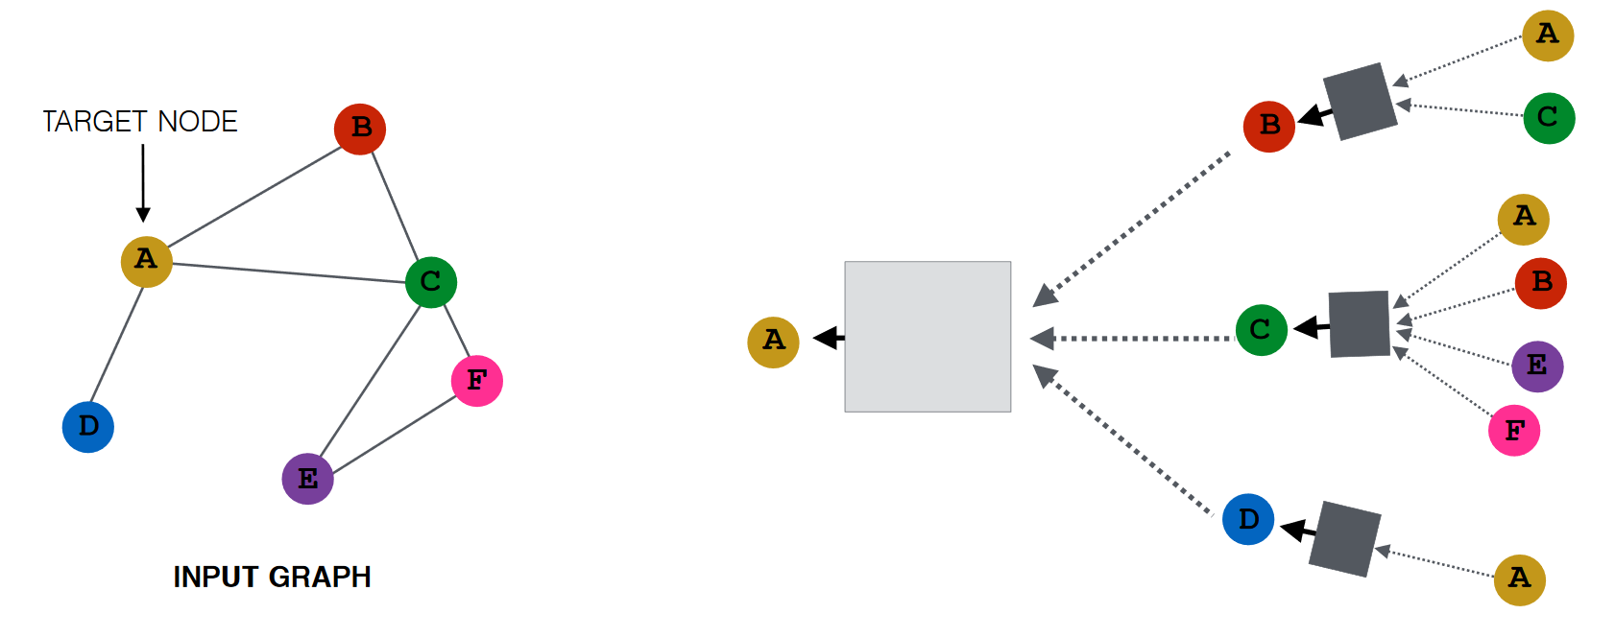

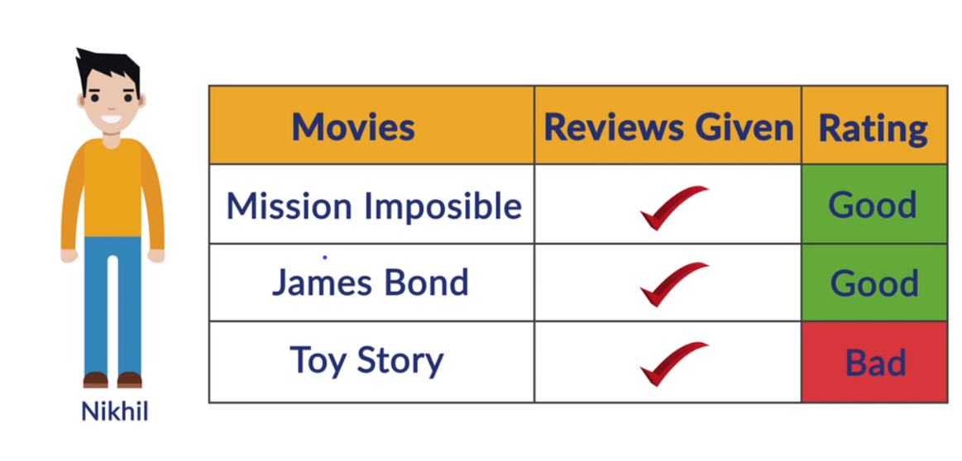
Graph Neural Network
Graph Structure
Prediction, Recommendation,
Classification…
GNNs
Node Features

Slide 11
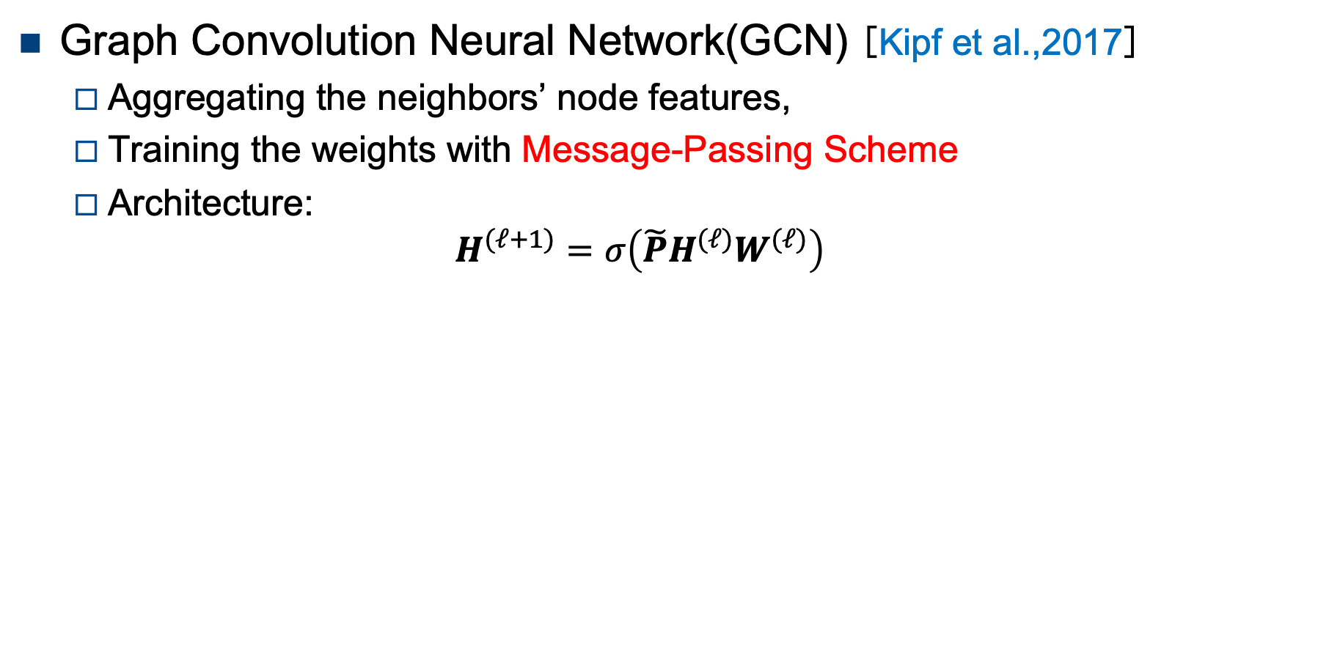
Graph Neural Network
Graph Convolution Neural Network(GCN) [Kipf et al.,2017]
Aggregating the neighbors’ node features,
Training the weights with Message-Passing Scheme
Architecture:
$$H^{(ℓ+1)}=σ\left(\tilde{P}H^{(ℓ)}W^{(ℓ)}\right)$$
neural networks
neural networks
neural
networks
neural networks

Slide 12
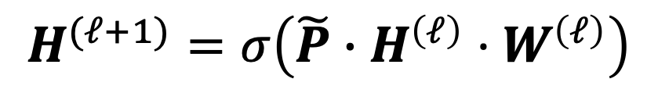
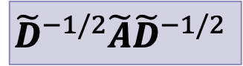
Message passing scheme
$$H^{(ℓ+1)}=σ\left(\tilde{P}∙H^{\left(ℓ\right)}⋅W^{\left(ℓ\right)}\right)$$
1
0
2
$${\tilde{D}}^{−1/2}\tilde{A}{\tilde{D}}^{−1/2}$$
representation of previous layer
weight matrix
5
3
4
Node | Features1 | Features2 | Features3 | Features4 | Features5 | Features6
x₀ | 1 | 0 | 0 | 0 | 0 | 0
x₁ | 0 | 1 | 0 | 0 | 0 | 0
x₂ | 0 | 0 | 1 | 0 | 0 | 0
x₃ | 0 | 0 | 0 | 1 | 0 | 0
x₄ | 0 | 0 | 0 | 0 | 1 | 0
x₅ | 0 | 0 | 0 | 0 | 0 | 1
x₀
x₀
Sum | 0 | 1 | 1 | 1 | 0 | 0
Self-loop | 1 | 1 | 1 | 1 | 0 | 0
Symmetry | 1/$\sqrt{4}$ $\sqrt{4}$ | 1/ $\sqrt{4}$ $\sqrt{3}$ | 1/ $\sqrt{4}$ $\sqrt{5}$ | 1/ $\sqrt{4}$ $\sqrt{2}$ | 0 | 0

Slide 13

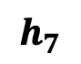
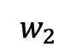
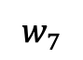
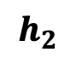
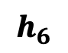
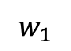
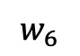
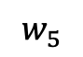
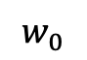
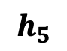
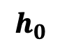
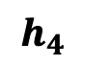
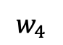
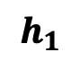
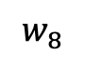
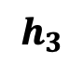
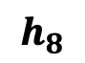
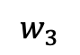
GCN and CNN
CNN is also a (Message-Passing) GNN
Aggregating the eight neighbors‘ and its own features
$$h_{1}$$
$$h_{2}$$
$$h_{3}$$
$$w_{1}$$
$$w_{0}$$
$$w_{2}$$
$$w_{3}$$
$$h_{8}$$
$$w_{8}$$
$$h_{0}$$
$$w_{4}$$
$$h_{4}$$
$$w_{7}$$
$$w_{5}$$
$$w_{6}$$
$$h_{7}$$
$$h_{6}$$
$$h_{5}$$

Slide 14
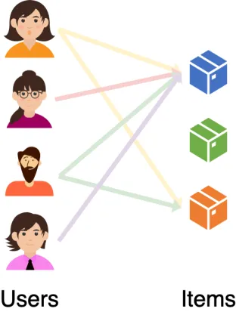

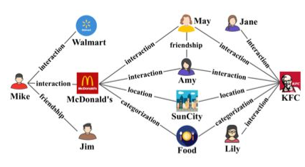
Recommendation system
The recommendation system's data can be directly used on GNNs.
Use-item graph
Social network
Knowledge Graph

Slide 15

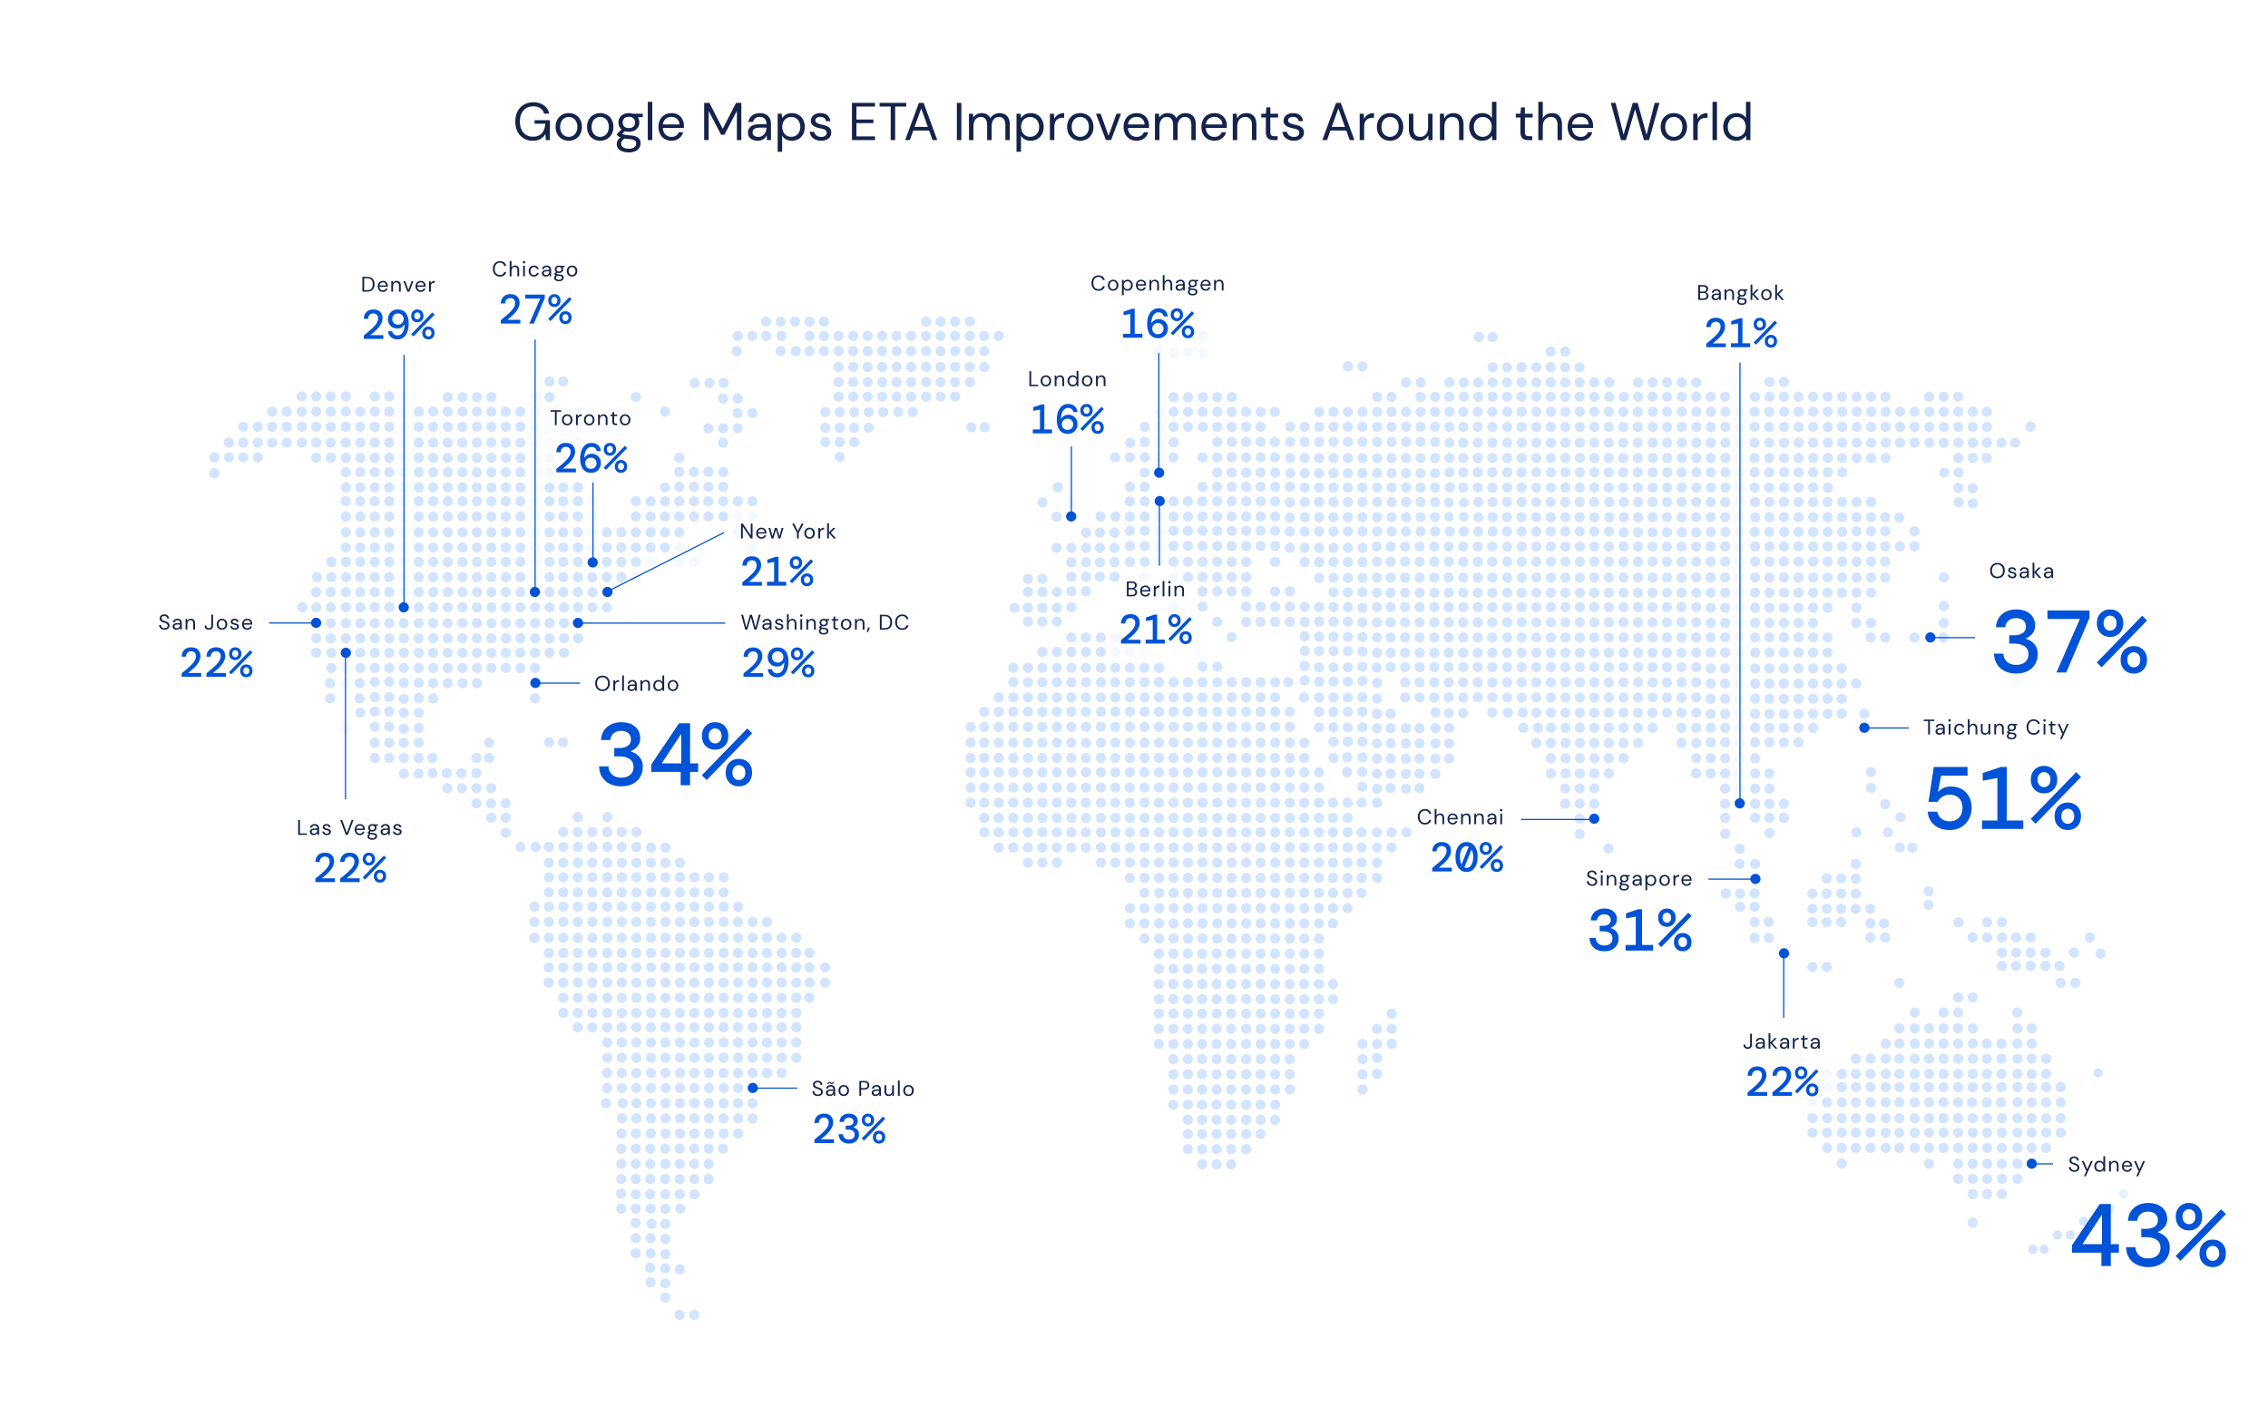
Traffic Forecast
DeepMind uses GNN to improve the travel time prediction of Google Map
Derrow-Pinion A, She J, Wong D, et al. Eta prediction with graph neural networks in google maps. In CIKM 2021.

Slide 16
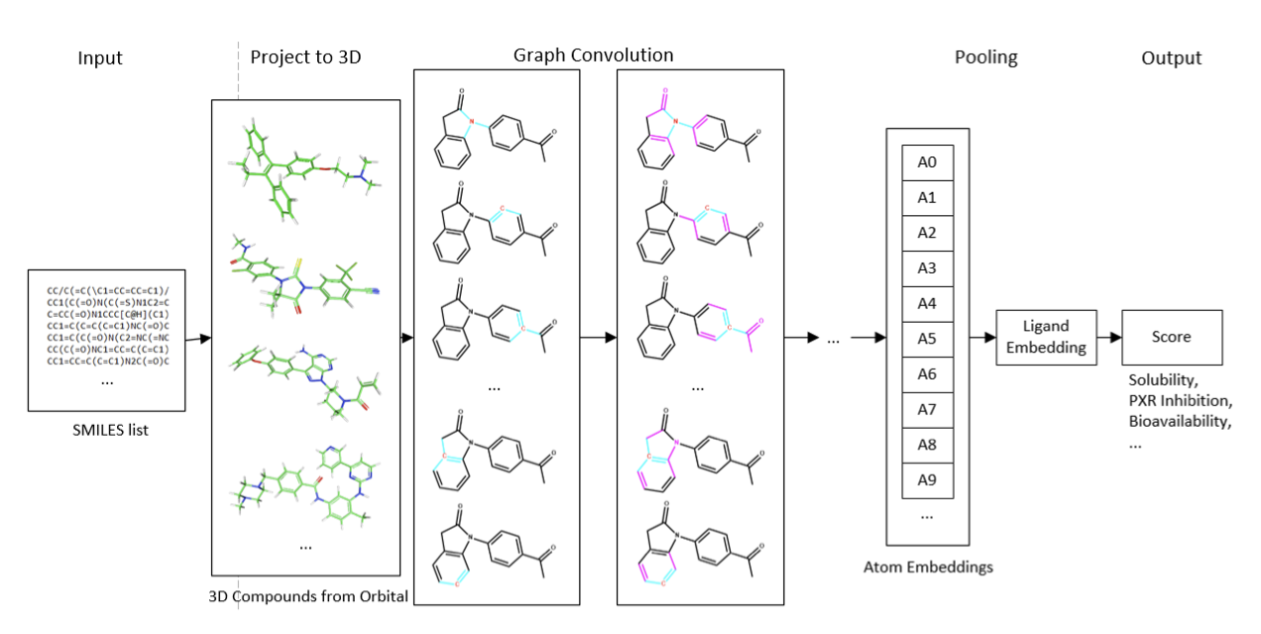
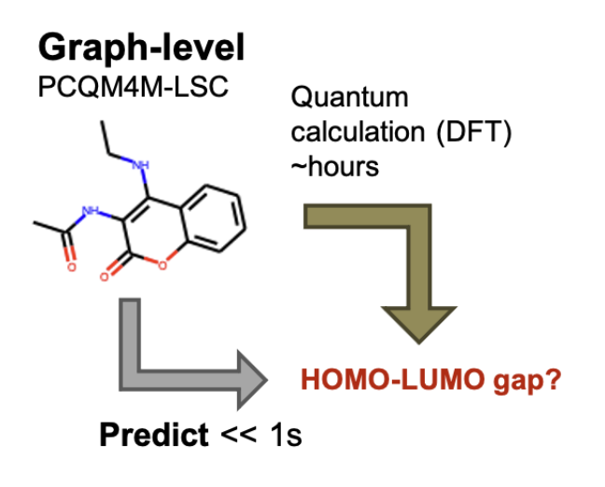
Drug Discovery
2021 KDD Cup: Predicting quantum properties of molecular graphs
https://ogb.stanford.edu/kddcup2021

Slide 17
Outline
Overview of GNNs
Spectral interpretation of GNNs
Our works (GCNII, BernNet, ChebNetII)
Summary & Perspectives

Slide 18
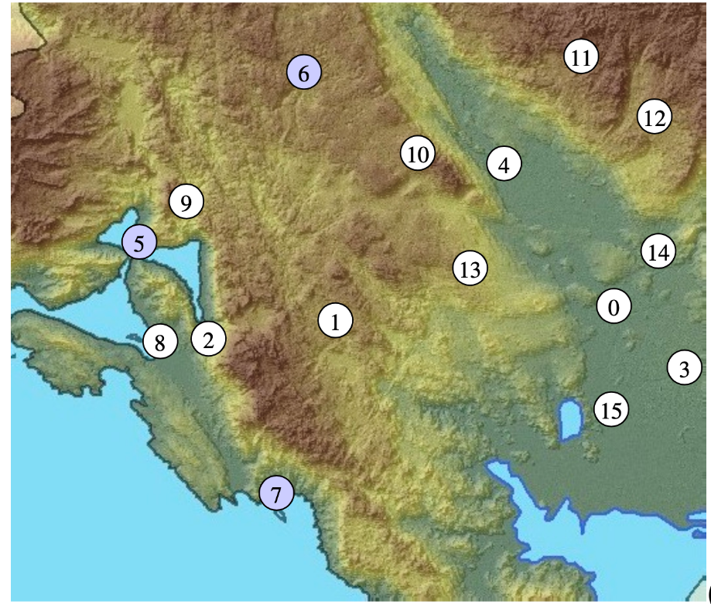
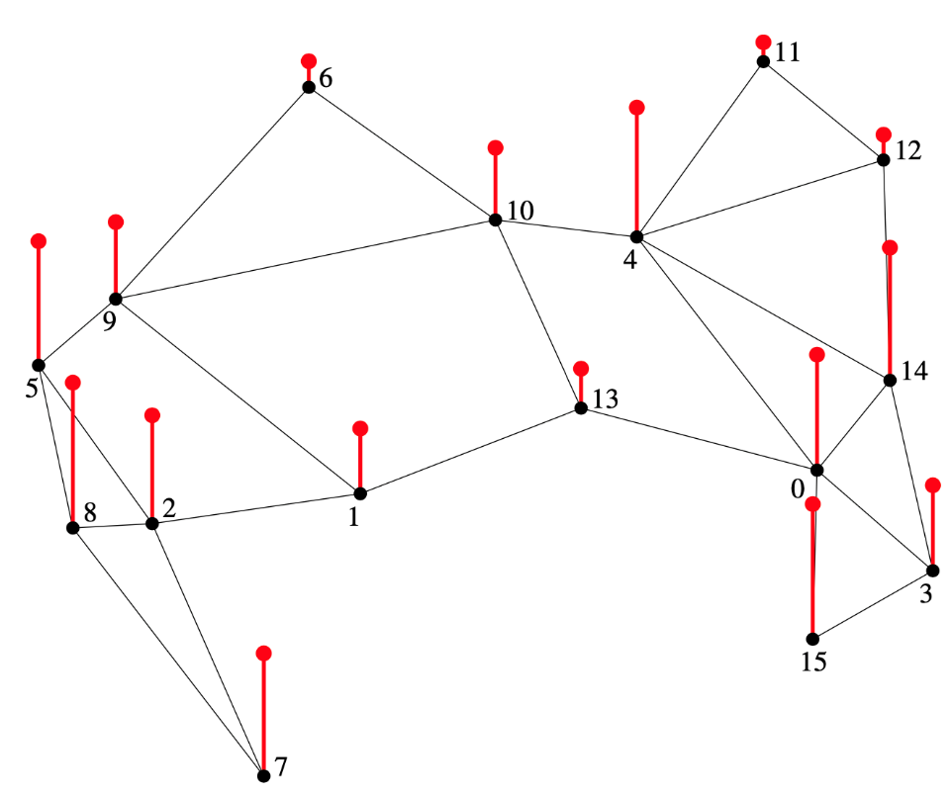
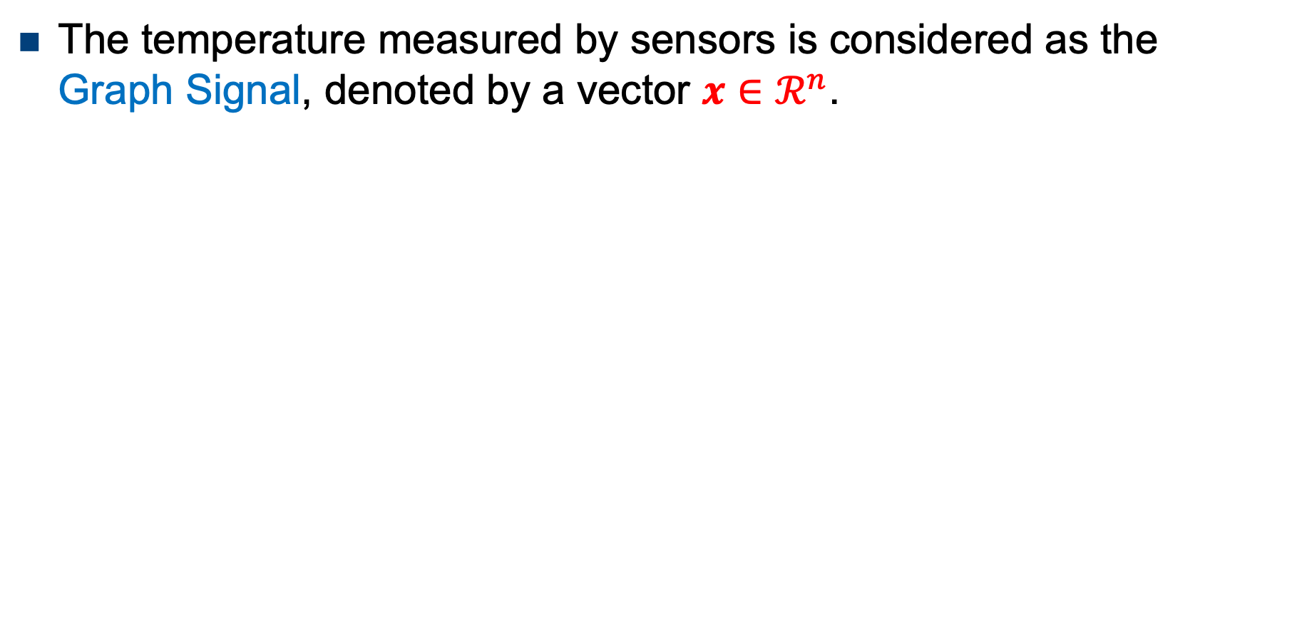
Graph Signal
The temperature measured by sensors is considered as the Graph Signal, denoted by a vector $x∈ℛ^{n}$.

Slide 19
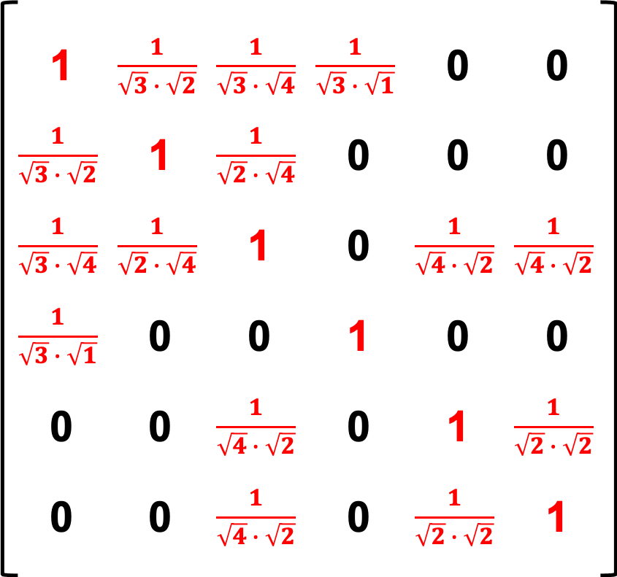



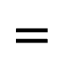
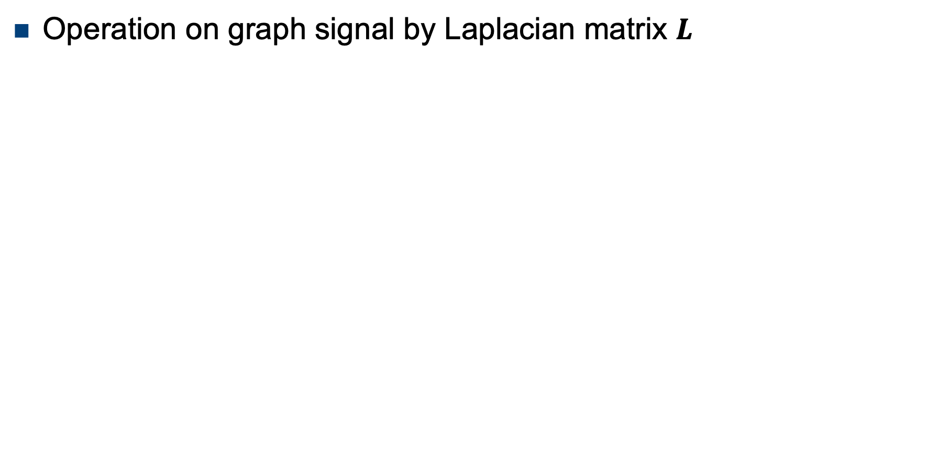

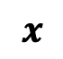
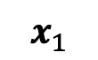
Graph Signal
Operation on graph signal by Laplacian matrix $L$
$$x_{1}=\left(2I−L\right)x$$
1
1
0
2
0
2
3
5
3
5
4
4
$$x$$
$$x_{1}$$
$$∙$$
$$=$$

Slide 20
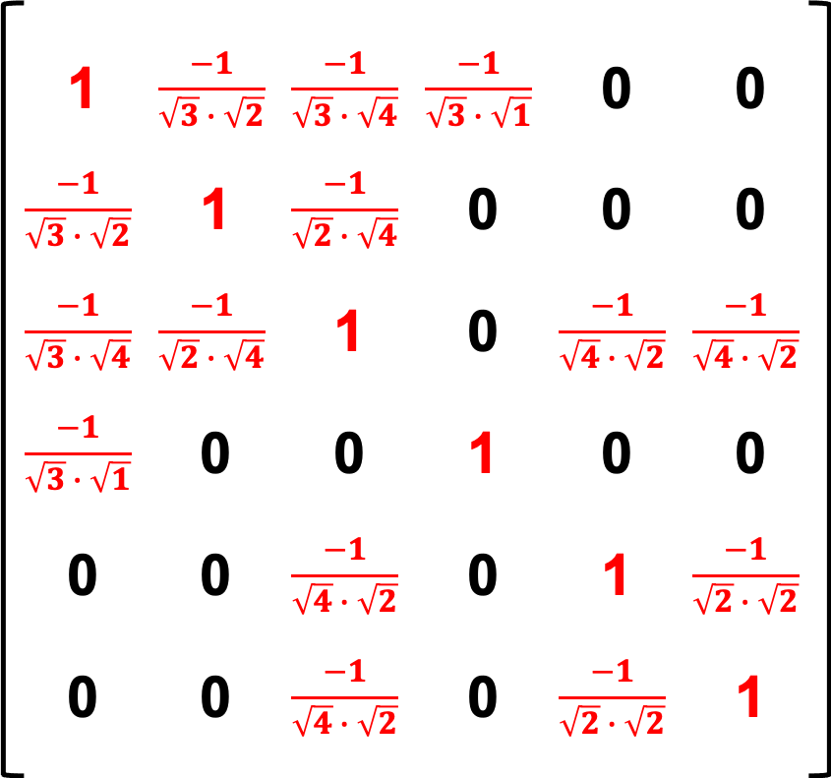


Graph Signal
Operation on graph signal by Laplacian matrix $L$
$$x_{1}=Lx$$
1
1
0
2
0
2
3
5
3
5
4
4
$$x$$
$$x_{1}$$
$$∙$$
$$=$$

Slide 21
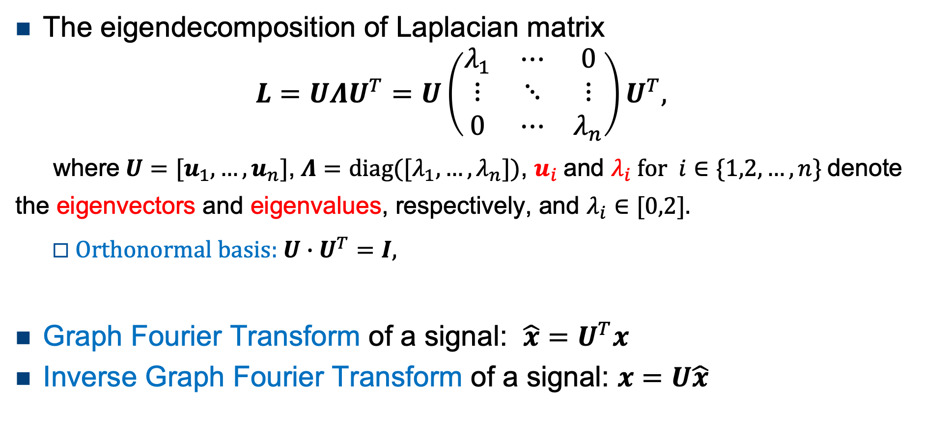
Graph Fourier Transform
The eigendecomposition of Laplacian matrix
$$L=UΛU^{T}=U\left(\begin{matrix}λ_{1} & ⋯ & 0 \\ ⋮ & ⋱ & ⋮ \\ 0 & ⋯ & λ_{n}\end{matrix}\right)U^{T},$$
where $U=[u_{1},…,u_{n}]$, $Λ=diag([λ_{1},…,λ_{n}$]), $u_{i}$ and $λ_{i} for i∈\{1,2,…,n\}$ denote the eigenvectors and eigenvalues, respectively, and $λ_{i}∈[0,2]$.
Orthonormal basis: $U∙U^{T}=I,$
Graph Fourier Transform of a signal: $\hat{x}=U^{T}x$
Inverse Graph Fourier Transform of a signal: $x=U\hat{x}$
Notes:
Symmetric, Positive semi-definite matrix

Slide 22
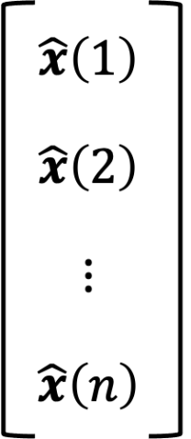








Graph Fourier Transform
$U^{T}x$ projects $x$ to the orthogonal basis consisting of $u_{1},…,u_{n}$
Fourier Transform
$$=$$
$$∙$$
Graph Fourier Transform
Ring Graph
Eigenvectors

Slide 23





Graph Filter
Given a graph signal $x$：
We call $h(Λ)/h(λ)$ (graph) filter.
$$y=h\left(L\right)x={Uh\left(Λ\right)U}^{T}x$$
$$=U diag\left[h\left(λ_{1}\right),…,h\left(λ_{n}\right)\right] U^{T}x$$
3. Inverse Graph Fourier Transform
2. Filtering
1. Graph Fourier Transform
$${Uh\left(Λ\right)U}^{T}x$$
$${h(Λ)U}^{T}x$$
$$U^{T}x$$

Slide 24

Graph Convolution
(Convolution theorem): the Fourier transform of a convolution of two signals is the pointwise product of their Fourier transforms.
$$x∗_{G}g=U\left(\left(U^{T}x\right)⨀\left(U^{T}g\right)\right)$$
where $⨀$ denotes Hadamard products, $U^{T}g$ is the convolution filter. Define $U^{T}g$ as a function of eigenvalues(e.g. $U^{T}g={\left[h\left(λ_{1}\right),…,h\left(λ_{n}\right)\right]}^{T}$) and let $h\left(Λ\right)=$ $diag\left[h\left(λ_{1}\right),…,h\left(λ_{n}\right)\right]$：
Many well-known GNNs assume$g_{θ}≡h(λ)$.
$$x∗_{G}g={Ug_{θ }U}^{T}x$$
3. Inverse Graph Fourier Transform
2. Convolution operation
1. Graph Fourier Transform

Slide 25






Homo./Heterophilic Graph & Filter
4
5
Impulse low-pass
4
5
3
6
$$y=U\left[\begin{matrix}1 & ⋯ & 0 \\ ⋮ & ⋱ & ⋮ \\ 0 & ⋯ & 0\end{matrix}\right]U^{T}x$$
3
6
2
7
2
7
Homophilic graph
1
8
1
8
4
5
Impulse high-pass
4
5
3
6
$$y=U\left[\begin{matrix}0 & ⋯ & 0 \\ ⋮ & ⋱ & ⋮ \\ 0 & ⋯ & 1\end{matrix}\right]U^{T}x$$
3
6
2
7
2
7
Heterophilic graph
1
8
1
8

Slide 26


Graph Filter
How to design arbitrary filters?
The complexity of eigendecomposition is too high.
Approximating filters by polynomials.
$$y≈{U\left(\begin{matrix}\sum_{k=0}^{K}{w_{k}{λ_{1}}^{k}} & ⋯ & 0 \\ ⋮ & ⋱ & ⋮ \\ 0 & ⋯ & \sum_{k=0}^{K}{w_{k}{λ_{n}}^{k}}\end{matrix}\right)U}^{T}x=\sum_{k=0}^{K}{w_{k}L^{k}x}$$
$$y=U\left(\begin{matrix}h(λ_{1}) & ⋯ & 0 \\ ⋮ & ⋱ & ⋮ \\ 0 & ⋯ & h(λ_{n})\end{matrix}\right)U^{T}x$$

Slide 27




Spectral-based GNNs
ChebNet [Defferrard et al., 2016] approximates the filters with Chebyshev basis.
$\hat{L}=$ $2L/λ_{max}−I$ denotes scaled Laplacian，$T_{k}\left(\hat{L}\right)$ is Chebyshev basis,
$W$ is the weight matrix and $H$ is the representation of each layer($H^{(0)}=X$).
Filtering operation: $h\left(λ\right)=\sum_{k=0}^{K}{w_{k}T_{k}\left(λ\right)}$.
$H^{(ℓ+1)}=σ\left(\sum_{k=0}^{K}{T_{k}(\hat{L})}H^{(ℓ)}W^{(ℓ,k)}\right)$

Slide 28






Spectral-based GNNs
GCN[Kipf et al.,2017] uses a simplified first-order Chebyshev polynomial.
Filtering operation: (set $w_{0}=−w_{1}=θ$ in $\sum_{k=0}^{K=1}{w_{k}T_{k}\left(λ\right)}$)
The filter of K layer GCN: $h\left(\tilde{λ}\right)={(1−\tilde{λ})}^{K}$, a fixed low-pass filter.
$$y=\left(θI−θ(L−I)\right)x$$
$$=θ\left(2I−L\right)x$$
Renormalization trick
$$=θ\left(I+D^{−1/2}AD^{−1/2}\right)x$$
$$θ\left({\tilde{D}}^{−1/2}\tilde{A}{\tilde{D}}^{−1/2}\right)x$$
Accuracy of node classification on heterophilic graphs with GCN.

Slide 29















GCN
The filter of K layer GCN: $h\left(\tilde{λ}\right)={(1−\tilde{λ})}^{K}$. Leading to over-smoothing！
$K$=1
$K$=2
$K$=100
$$h(\tilde{λ})$$
$$h(\tilde{λ})$$
$$h(\tilde{λ})$$
$$\tilde{λ}$$
$$\tilde{λ}$$
$$\tilde{λ}$$

Slide 30
Outline
Overview of GNNs
Spectral interpretation of GNNs
Our works (GCNII, BernNet, ChebNetII)
Summary & Perspectives

Slide 31
Simple and Deep Graph Convolutional Networks (ICML, 2020)
Ming Chen, Zhewei Wei, Zengfeng Huang, Bolin Ding, Yaliang Li

Slide 32


Motivations
GCN is a linear low-pass filter, and stacking multiple layers leads to over-smoothing
Is it possible to train deeper GNN models and avoid over-smoothing?
$K$=2
$K$=100
$$h(\tilde{λ})$$
$$h(\tilde{λ})$$
$$\tilde{λ}$$
$$\tilde{λ}$$

Slide 33

GCNII
GCNII: Graph Convolutional Network via Initial residual and Identity mapping
Vanilla GCN
$$H^{(ℓ+1)}=σ\left(\tilde{P}H^{(ℓ)}W^{(ℓ)}\right)$$
Chen M, Wei Z et al. Simple and Deep Graph Convolutional Networks. [ICML’2020]

Slide 34

GCNII
GCNII: Graph Convolutional Network via Initial residual and Identity mapping
Vanilla GCN
$$H^{(ℓ+1)}=σ\left(\tilde{P}H^{(ℓ)}W^{(ℓ)}\right)$$
GCN+Initial residual
$$H^{(ℓ+1)}=σ\left(\left(\left(1−α_{𝓁}\right)\tilde{P}H^{(ℓ)}+α_{𝓁}H^{(0)}\right)W^{(ℓ)}\right)$$
Chen M, Wei Z et al. Simple and Deep Graph Convolutional Networks. [ICML’2020]

Slide 35

GCNII
GCNII: Graph Convolutional Network via Initial residual and Identity mapping
Vanilla GCN
$$H^{(ℓ+1)}=σ\left(\tilde{P}H^{(ℓ)}W^{(ℓ)}\right)$$
GCN+Initial residual
$$H^{(ℓ+1)}=σ\left(\left(\left(1−α_{𝓁}\right)\tilde{P}H^{(ℓ)}+α_{𝓁}H^{(0)}\right)W^{(ℓ)}\right)$$
GCNII
GCN+Initial residual+Identity mapping
$$H^{(ℓ+1)}=σ\left(\left(\left(1−α_{𝓁}\right)\tilde{P}H^{(ℓ)}+α_{𝓁}H^{(0)}\right)\left(\left(1−β_{𝓁}\right)I_{n}+β_{𝓁}W^{(ℓ)}\right)\right)$$
Chen M, Wei Z et al. Simple and Deep Graph Convolutional Networks. [ICML’2020]

Slide 36





GCNII vs GCN
GCN： $H^{( K)}={\tilde{P}}^{K}x$
GCNII： $H^{(K)}=\left(\sum_{i=0}^{K}{α{\left(1−α\right)}^{i}{\tilde{P}}^{i}}\right)x$
Linear low-pass filter,
leading to oversmooth.
Low-pass filter with fixed $s$,
avoiding oversmoothing.
Chen M, Wei Z et al. Simple and Deep Graph Convolutional Networks. [ICML’2020]

Slide 37

GCNII
GCN + residual connection [Kipf et al., 2017]
$$H^{(ℓ+1)}=σ\left(\left(\left(1−α_{𝓁}\right)\tilde{P}H^{(ℓ)}+α_{𝓁}H^{(0)}\right)\left(\left(1−β_{𝓁}\right)I_{n}+β_{𝓁}W^{(ℓ)}\right)\right)$$
At least the same performance as its shallow version (APPNP).
Chen M, Wei Z et al. Simple and Deep Graph Convolutional Networks. [ICML’2020]

Slide 38


Experiments
ours
Chen M, Wei Z et al. Simple and Deep Graph Convolutional Networks. [ICML’2020]

Slide 39


Experiments
ours
Chen M, Wei Z et al. Simple and Deep Graph Convolutional Networks. [ICML’2020]

Slide 40
BernNet: Learning Arbitrary Graph Spectral Filters via Bernstein Approximation (NeurIPS 2021)
Mingguo He, Zhewei Wei, Zengfeng Huang, Hongteng Xu

Slide 41
Motivations
GCN and GCNII use low-pass filters that are inapplicable to heterophilic graphs
ChebNet can adaptively learn filters, but the learned filters may be invalid, the learning is inefficient, and their robustness is questionable
Is there a polynomial graph filter that can learn/design arbitrary valid, efficient, and robust spectral filters?

Slide 42

Background
The valid polynomial graph spectral filter
This condition are not satisfied for some existing GNNs , e.g. GCN.
The Chebyshev polynomial approximation requires $h\left(λ\right)=\sum_{k=0}^{K}{w_{k}T_{k}(λ)}≥0$.
Lemma 3.1: Any non-negative polynomials on [0,2] can be written in the form of Bernstein polynomial
$h\left(λ\right)=\sum_{k=0}^{K}{w_{k}λ^{k}}≥0,∀λ∈\left[0,2\right]$
$h\left(λ\right)=\sum_{k=0}^{K}{θ_{k} \frac{1}{2^{k}}\left(\begin{aligned}K \\ k\end{aligned}\right){(2−λ)}^{K−k}λ^{k}}$
Bernstein polynomial coefficients, $θ_{k}≥0$
Bernstein basis that can approximate any polynomial
He M, Wei Z et al. BernNet: Learning Arbitrary Graph Spectral Filters via Bernstein Approximation. [NeurIPS’2021]

Slide 43


BernNet
Approximating filters via Bernstein polynomial
$$z=\left(\sum_{k=0}^{K}{θ_{k}\frac{1}{2^{k}}\left(\begin{aligned}K \\ k\end{aligned}\right){(2I−L)}^{K−k}L^{k}}\right)x$$
He M, Wei Z et al. BernNet: Learning Arbitrary Graph Spectral Filters via Bernstein Approximation. [NeurIPS’2021]

Slide 44











Bernstein Approximation
The coefficient $θ_{k}$can be set to $h(\frac{2k}{K})$, having better interpretability!
$$θ_{10}$$
$$θ_{0}×$$
$$θ_{0}$$
$$θ_{1}$$
$$θ_{9}$$
$$+$$
$$θ_{1}×$$
……
$$+$$
$$… …$$
$$+$$
$$θ_{9}×$$
$$+$$
$$θ_{10}×$$
$$z=\left(\sum_{k=0}^{K}{θ_{k}\frac{1}{2^{k}}\left(\begin{aligned}K \\ k\end{aligned}\right){(2I−L)}^{K−k}L^{k}}\right)x→h\left(L\right)x, k→∞$$
He M, Wei Z et al. BernNet: Learning Arbitrary Graph Spectral Filters via Bernstein Approximation. [NeurIPS’2021]

Slide 45




Experiment
Homophilic graphs
Heterophilic graphs
40.19_{±0 .56}
Learned filters
Coefficient $θ_{k}$
He M, Wei Z et al. BernNet: Learning Arbitrary Graph Spectral Filters via Bernstein Approximation. [NeurIPS’2021]

Slide 46
Experiment
Homophilic graphs
Heterophilic graphs
Learned filters
Coefficient $θ_{k}$
He M, Wei Z et al. BernNet: Learning Arbitrary Graph Spectral Filters via Bernstein Approximation. [NeurIPS’2021]

Slide 47
Convolutional Neural Networks on Graphs with Chebyshev Approximation, Revisited (NeurIPS 2022 Oral，1.5%)
Mingguo He, Zhewei Wei, Ji-Rong Wen

Slide 48


Motivations
GCN[Kipf et al.,2017] is a simplified form of ChebNet [Defferrard et al., 2016]
Chebyshev basis has a higher approximation ability compared to Monomial and Bernstein basis [Geddes,1978]
Why is ChebNet’s performance inferior to GCN’s despite its better expressiveness?
Why is ChebNet’s filter inferior to that of GPR-GNN and BernNet?
He M, Wei Z et al. Convolutional Neural Networks on Graphs with Chebyshev Approximation, Revisited . [NeurIPS’2022]

Slide 49






Chebyshev Expansion
Coefficient Constraints
For a continuous function $f\left(x\right)$ in [-1,1], we define its Chebyshev expansion as $f\left(x\right)=\sum_{k=0}^{∞}{w_{k}T_{k}(x)}$.
[Theorem 2.1] If $f(x)$is weakly singular at the boundaries and analytic in the interval (−1, 1), then $w_{k}$ will asymptotically (as $k→∞$) decrease proportionally to $1/k^{q}$for some positive constant $q$.
Empirical validation
ChebBase: $Y=\sum_{k=0}^{K}{w_{k}T_{k}(\hat{L}})f_{θ}\left(X\right)$
ChebBase$/k$: $Y=\sum_{k=0}^{K}{\frac{w_{k}}{k}T_{k}(\hat{L}})f_{θ}\left(X\right)$
He M, Wei Z et al. Convolutional Neural Networks on Graphs with Chebyshev Approximation, Revisited . [NeurIPS’2022]

Slide 50





ChebNetII
Use Chebyshev Interpolation to learn the graph filters
$$Y=\frac{2}{K+1}\sum_{k=0}^{K}{\sum_{j=0}^{K}{γ_{j}T_{k}\left(x_{j}\right)}T_{k}\left(\hat{L}\right)f_{θ}(X)}$$
Reparameterize coefficient
$w_{k}$ by $w_{k}=\sum_{j=0}^{K}{γ_{j}T_{k}\left(x_{j}\right)}$
$γ_{j}$ is the learnable parameter, corresponding to filter value $h(x_{j})$
$x_{j}=cos⁡(\left(j+1/2\right)π/(K+1)$ is the Chebyshev Node
He M, Wei Z et al. Convolutional Neural Networks on Graphs with Chebyshev Approximation, Revisited . [NeurIPS’2022]

Slide 51


Experiments
Semi-supervised node classification
Full-supervised node classification
He M, Wei Z et al. Convolutional Neural Networks on Graphs with Chebyshev Approximation, Revisited . [NeurIPS’2022]

Slide 52



Experiments
Comparison between Different Polynomial Bases
Scalability
He M, Wei Z et al. Convolutional Neural Networks on Graphs with Chebyshev Approximation, Revisited . [NeurIPS’2022]

Slide 53
Outline
Overview of GNNs
Spectral interpretation of GNNs
Our works (GCNII, BernNet, ChebNetII)
Summary & Perspectives

Slide 54
Summary
The theoretical foundation of GCN is the graph signal theory.
GCN is a linear low-pass filter, and stacking multiple layers leads to over-smoothing.
GCNII can avoid over-smoothing.
GCN and GCNII use fixed filters that are inapplicable to heterophilic graphs.
BernNet, ChebNetII can learn arbitrary filters.
Chebyshev basis has a stronger approximation ability.
Perspectives
Theoretical assumptions of graph machine learning.
Efficient computation of spectral-based GNN.

Slide 55





























Team Members & Collaborators
Team Members
Zhe Yuan
Hanzhi Wang
Yanping Zheng
Mingguo He
Jiajun Li
Tianjing Zeng
Fangrui Lv
Zhewei Wei
Gengmo Zhou
Yuhe Guo
Jinjia Feng
Yang Zhang
Ruoqi Zhang
Xu Liu
Mingji Yang
Haipeng Ding
Lu Yi
Runlin Lei
Guanyu Cui
Jingyu Chen
Jiahong Ma
Xiang Li
Collaborators
Sibo Wang
Jiajun Liu
Zengfeng Huang
Hongteng Xu
Bolin Ding
Yaliang Li
Zhen Wang

Slide 56
Thanks! Q&A

